Slide 1
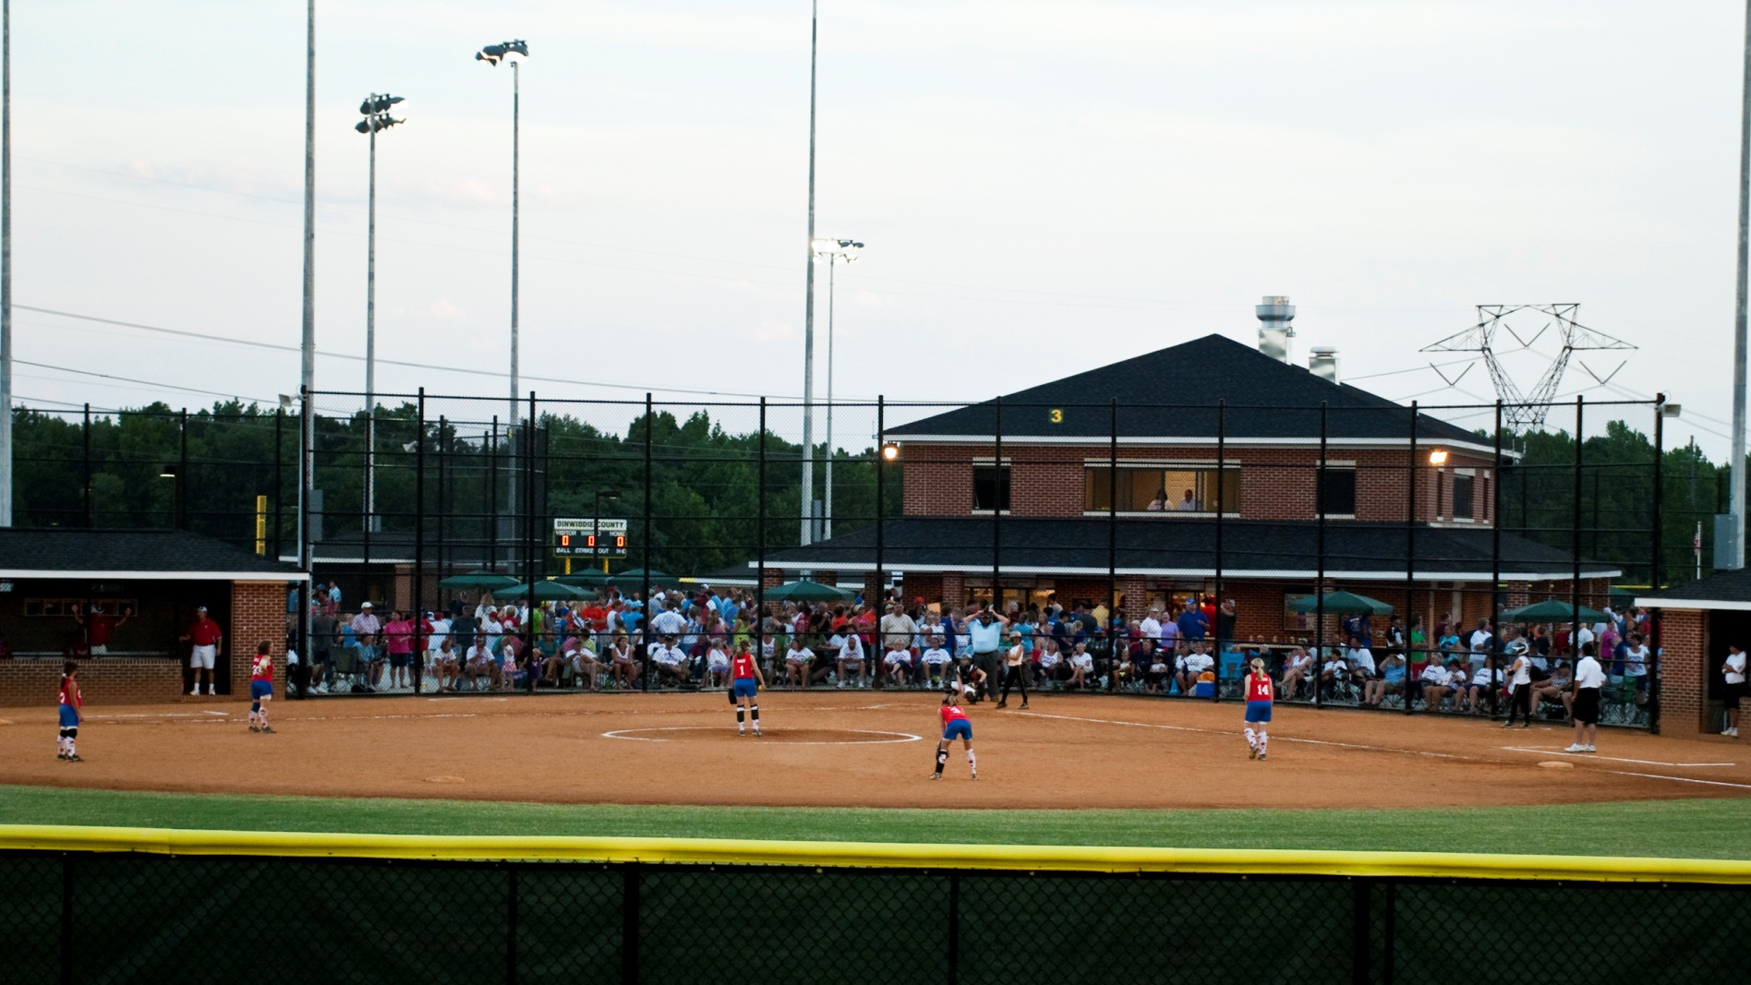



YOU ARE INVITED TO VISIT
Sports Complex
5850 R.B. Pamplin Dr. Sutherland, VA 23885 Phone: 804-862-8086 Fax: 804-862-8097 Email: DCPR@dinwiddieva.us

Slide 2
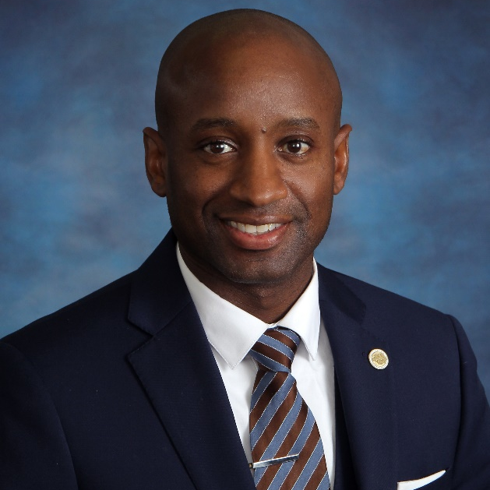
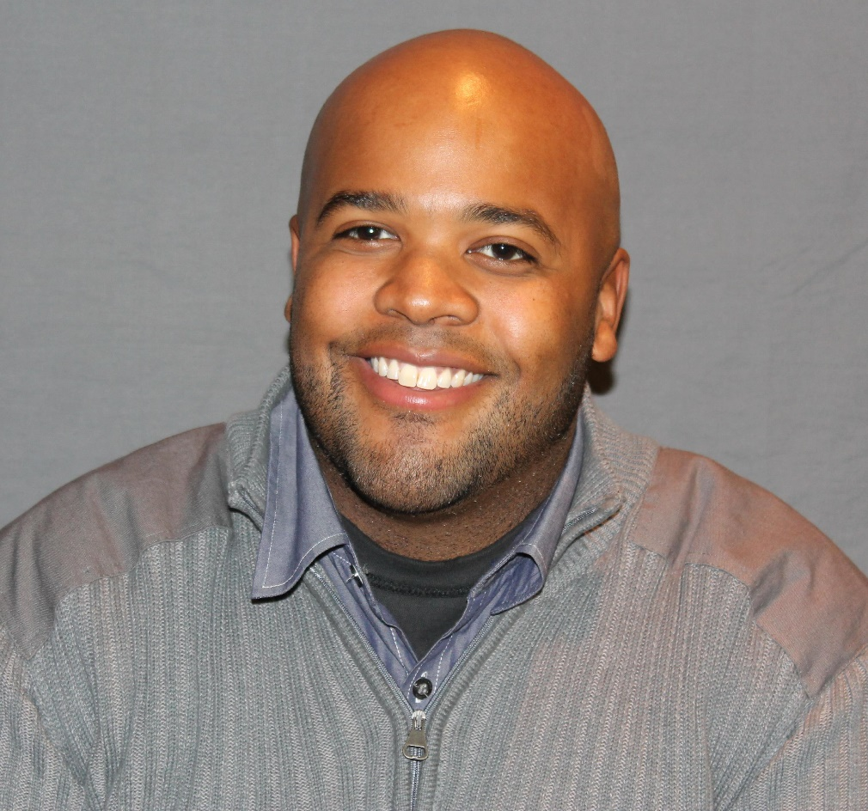
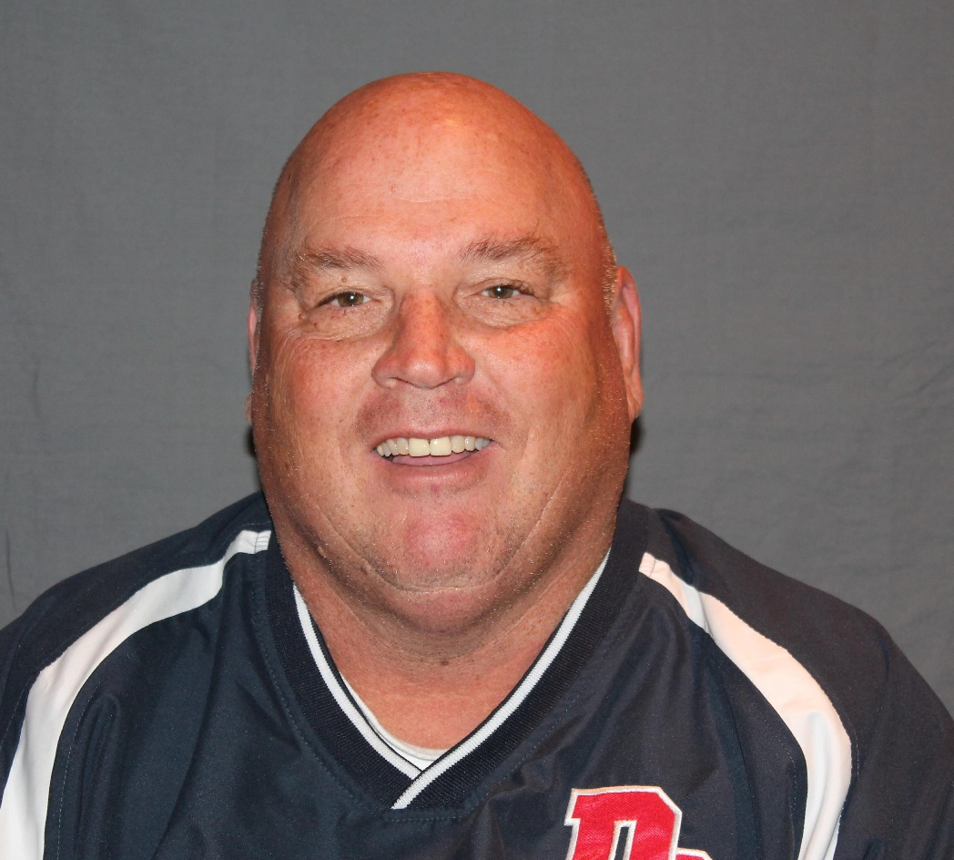
TEAM
TEAM
J. Rayfield Vines III
Marquis Allen
Director of Parks and Recreation
Assistant Director of Parks and Recreation
Raymond Pauley JR.
Assistant Director of Public Works

Slide 3
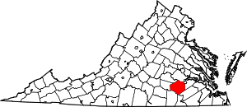
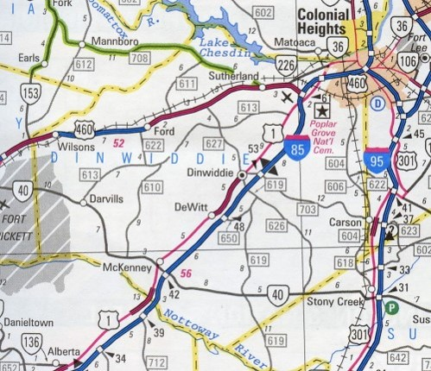
The Dinwiddie County Sports Complex is located in Dinwiddie, VA. Dinwiddie is situated just off of major interstates and through fairs such as I-95, I-85, and route 460. With numerous attractions and amenities within the county and the surrounding communities (Colonial Heights, Petersburg, and Chesterfield), the Sports Complex is sure to offer its visitors an experience of a lifetime both on the field and off.
LOCATION
LOCATION
Visitors have the opportunity to enjoy rich Civil War history at Pamplin Park or Five Forks, fine dining in Old Towne Petersburg, or shopping in Southpark Mall. Dinwiddie County offers opportunities for the entire family.

Slide 4
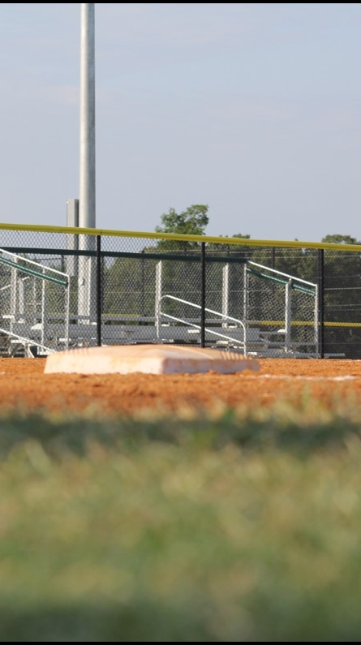
Three (3) youth softball (all ages) and/or youth baseball fields (12 and under)
One (1) adult baseball and/or softball field
Regulation size football field
Wireless electronic scoreboards and controllers
Parking at the Dinwiddie Sports Complex along with auxiliary parking available at Sutherland Elementary
Full service concession stand
Lighted brick dugouts with bat and helmet racks
Bermuda grass outfields
Concrete concourse with patio seating
1st and 3rd base foul line bleacher seating
Men’s and Women’s restroom facilities
*ADA Accessible
*Wireless Internet Access
OVERVIEW
OVERVIEW

Slide 5

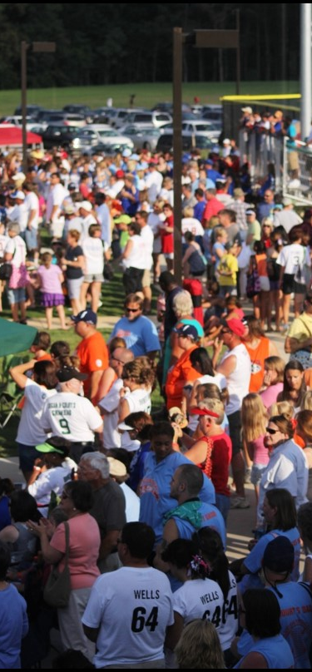
Business Hours
9:30am – 5:00pm
Monday through Friday
Operating Schedule
March 1st through October 31st
8:00am – Midnight
SCHEDULE
HOURS/SCHEDULE

Slide 6
Fields and Fees | Level 1 | Level 2 | Level 3 | Level 4
Instructional, Youth, and Intermediate Soccer Field Rental Fee | N/A | N/A | $50.00 (per day, per field) | $50.00 (per day, per field)
Regulation Soccer Field Rental Fee | N/A | N/A | $100.00 (per day) | $100.00 (per day)
Baseball and Softball Field Rental Fee | N/A | N/A | $100.00 (per day, per field) | $100.00 (per day, per field)
Regulation Football Field | N/A | N/A | $500.00 (per day) | $500.00 (per day)
Basic Baseball and Softball Field Preparation Fee * | N/A | $25.00 (per field, per game) | $25.00 (per field, per game) | $25.00 (per field, per game)
Advanced Baseball and Softball Field Preparation Fee ** | N/A | $75.00 (per field, per game) | $75.00 (per field, per game) | $75.00 (per field, per game)
Football Game-Day Equipment Rental Fee *** | N/A | N/A | $500.00 (per day) | $500.00 (per day)
Practice Fee (each baseball, softball, football, and soccer field) **** | N/A | $20.00 (per field, per day) | $20.00 (per field, per day) | $20.00 (per field, per day)
INFORMATION
INFORMATION
* Fee includes raking of baselines, mound area, and home plate area, along with minor repairs to the lines
** Fee includes dragging of the infield, watering of the infield, complete re-lining of the field, and raking of the pitches mound, home plate area, and baselines
*** Equipment includes the first down chains and markers, the end zone pylons, the yard markers, and the goal post pads
**** Level 2 programs are not required to pay the practice fee if the practices are being held during their regular season. Level 2 programs, however, are required to pay the practice fee if the practices are held after the completion of the regular season.

Slide 7
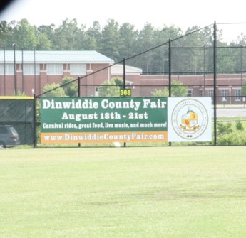
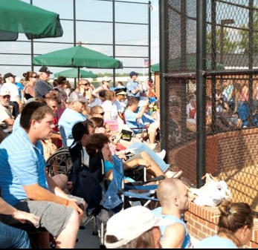
Skinned infield with Bermuda grass outfield
277’ to 375’ outfield fence
30’ fence in right field (277’ down the right field line)
Bleacher seating available down 1st & 3rd base foul lines that can accommodate 102 spectators.
Concourse seating available behind home plate.
Base placement: 60’ or 90’
PA system and wireless scoreboard operations located within the press box located behind home plate.
Temporary fencing available to adjust field dimensions
FIELD 1
YOUTH BASEBALL/SOFTBALL

Slide 8
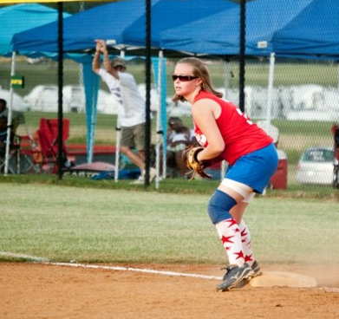
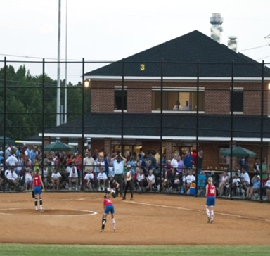
Designed for all age groups in softball
Designed for under 12 year old baseball participants
201’ – 207’ to outfield fence
Bleacher seating available down 1st & 3rd base foul lines that can accommodate 102 spectators
Concourse seating available behind home plate
Permanent pitching mound not available. Pitching rubber distances can be altered to accommodate league requirements
PA system and wireless scoreboard operations located within the press box located behind home plate
FIELDS 2,3&4
YOUTH BASEBALL/SOFTBALL

Slide 9
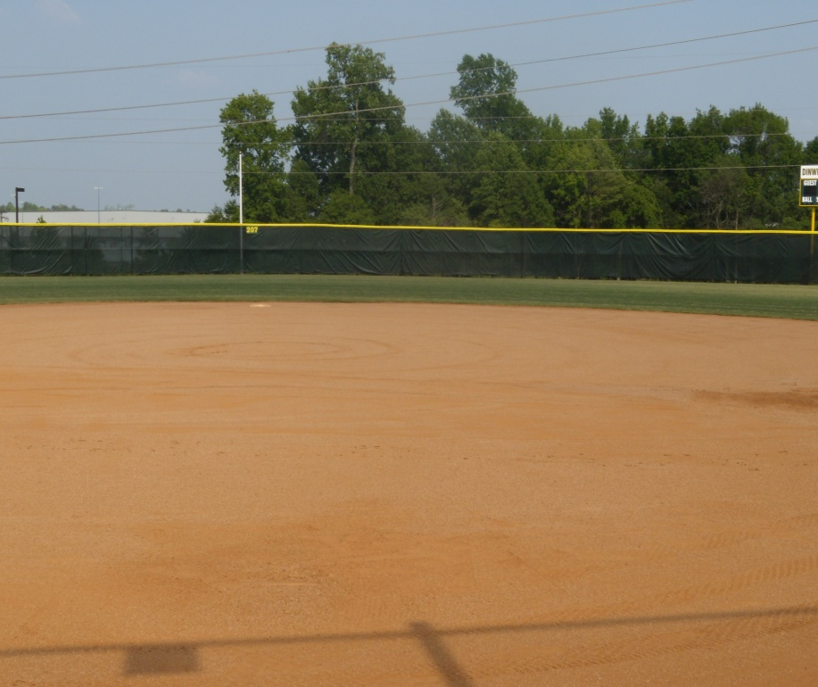
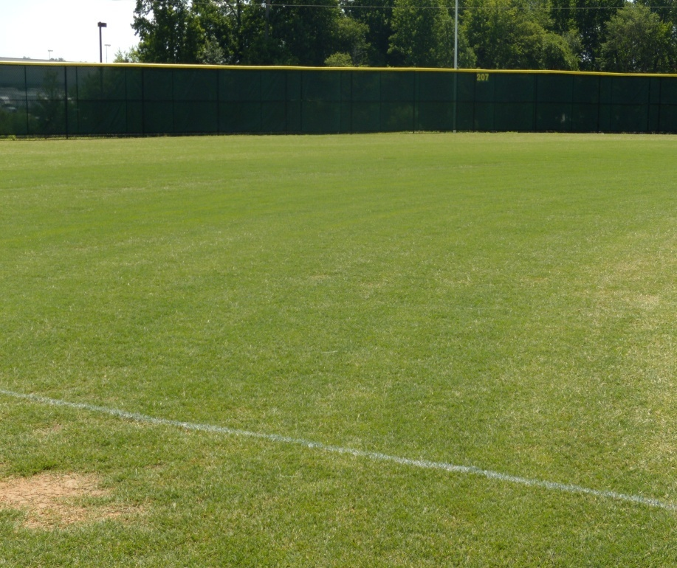
CLAY MIX INFIELDS
QUALITY
FIELD QUALITY
BERMUDA GRASS OUTFIELDS

Slide 10
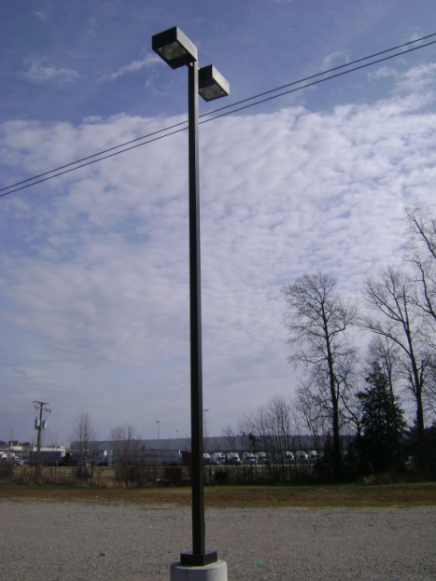
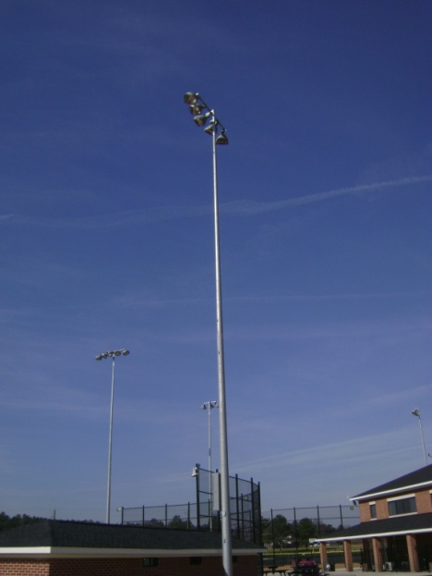
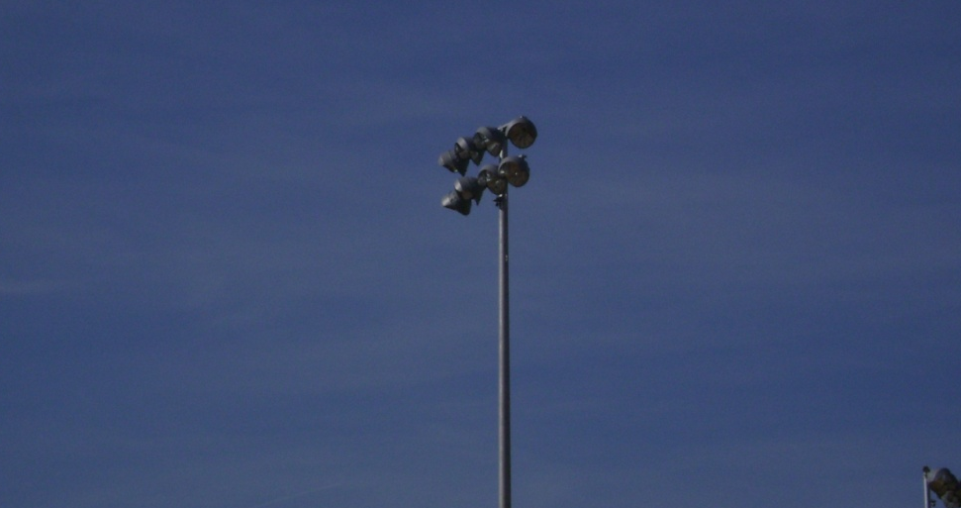
The softball, baseball, and football fields are equipped with recreational grade lighting
Field lighting was installed and designed by Musco Lighting
All lights are monitored and controlled via computer
LIGHTING
LIGHTING
Additional light
features include:
Parking lot lights
Walkway lights
Security lights

Slide 11
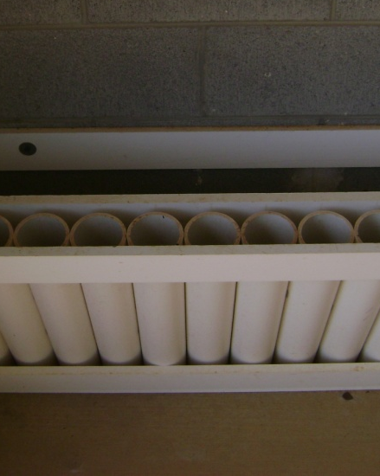
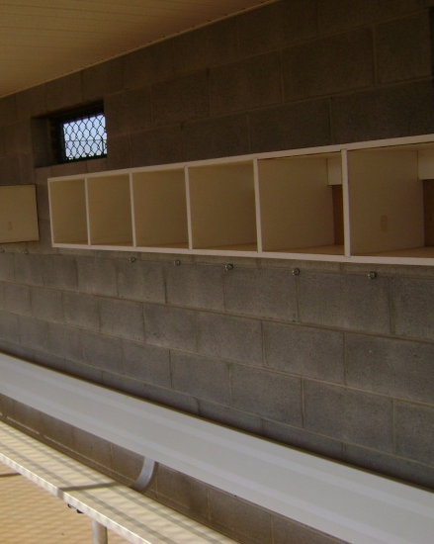
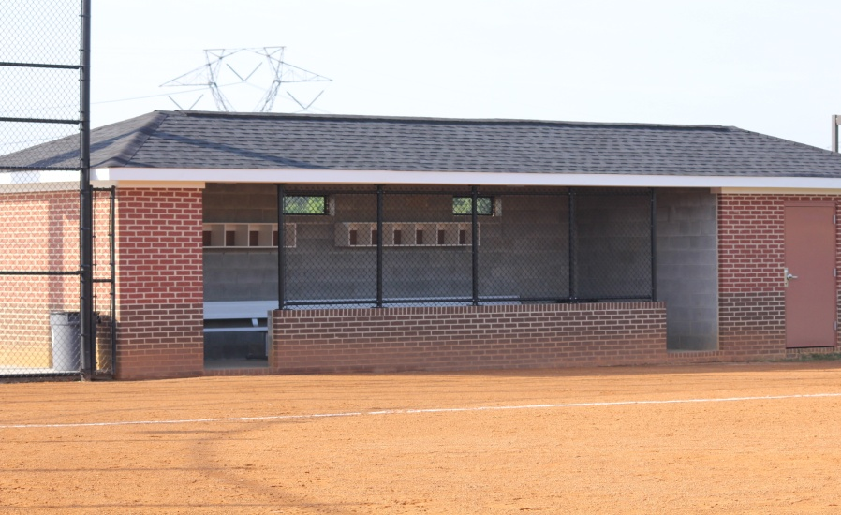
All dugouts include:
Bat holders
Helmet and storage bins
Bag holders
Water cooler stands
DUGOUTS
DUGOUTS

Slide 12
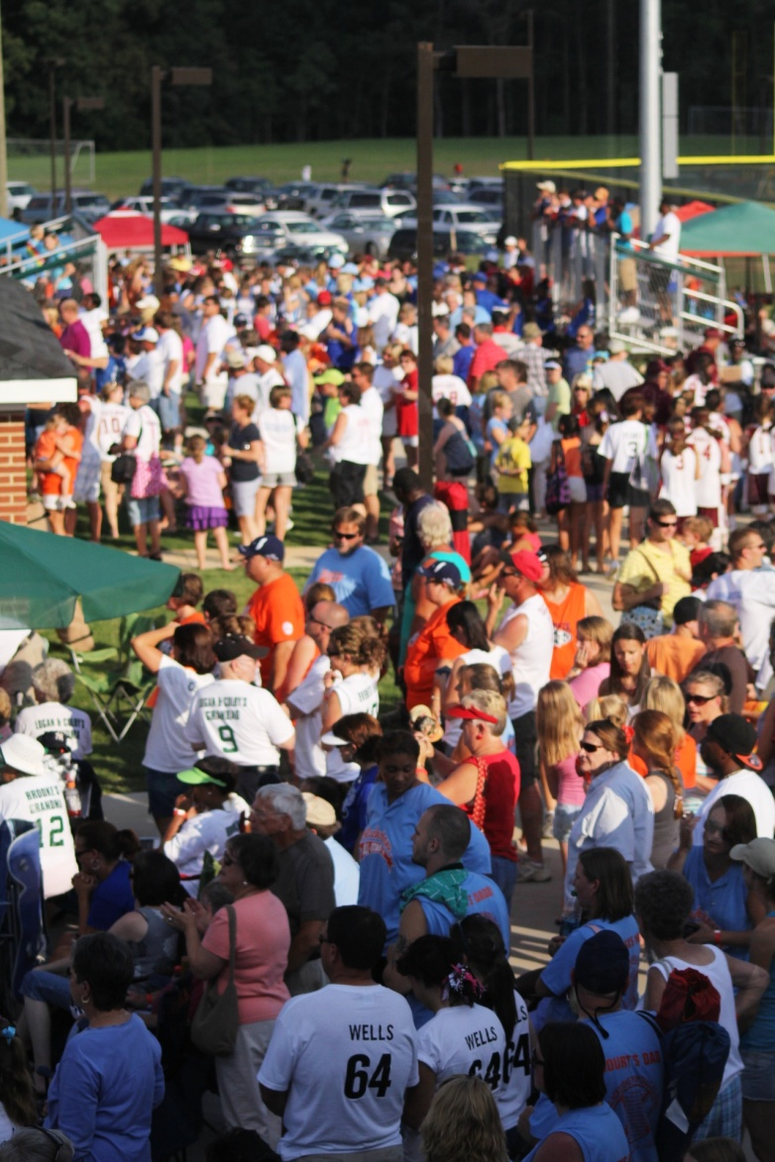
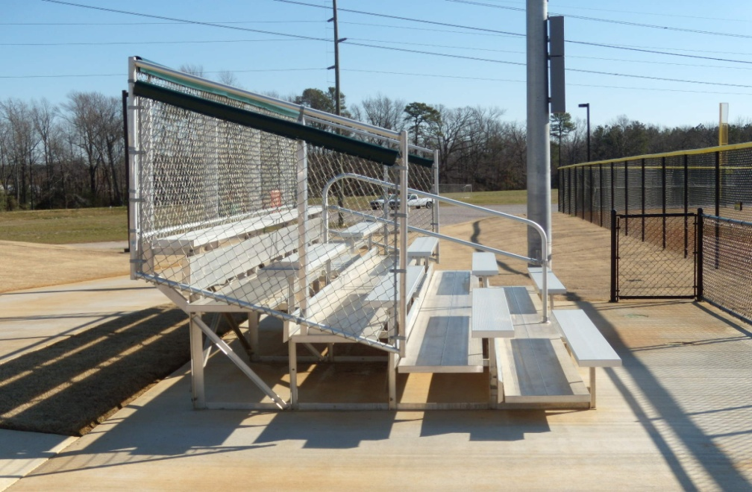
Two (2) sets of bleachers per field
Seating capacity of 81 people per bleacher
ADA accessible
BLEACHERS
BLEACHERS

Slide 13
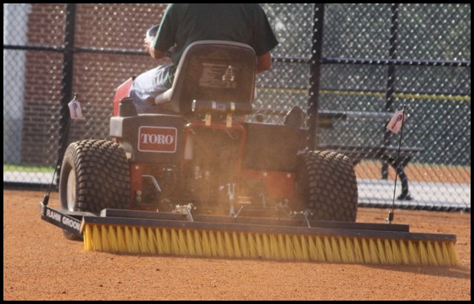
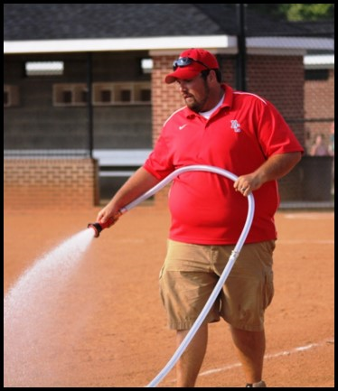
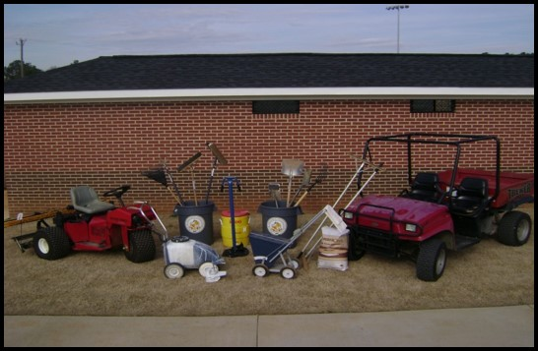
Dinwiddie County Parks & Recreation offers the highest level of customer service in regards to field preparation
Our department will guarantee that your field is properly dragged, lined, and edged to meet your performance needs the day of your practice, game, or tournament
Regardless of the weather, proper techniques will be utilized to ensure the best playing surface possible is provided
SERVICE
FIELD PREP

Slide 14

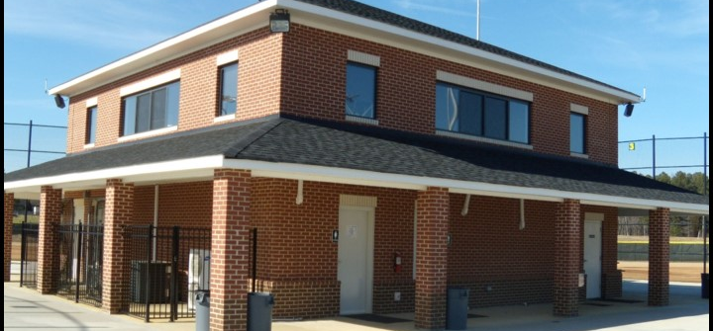
Main Concourse Includes:
Concession Stand
Press Boxes (each field)
Patio seating
Restrooms
Administration offices
CONCOURSE
CONCOURSE

Slide 15
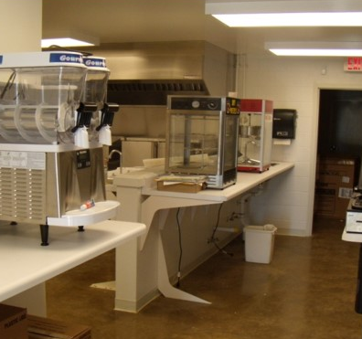
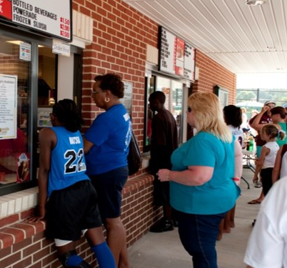
Full service concession stand that offers great customer service and a variety of treats
Menu includes:
Hamburgers
Cheeseburgers
Chicken Sandwich
Chicken Nuggets and Tenders
Coffee
Hot Dogs
BBQ Sandwiches
Frozen Slush
Ice Cold Coke Products
Popcorn
Ice Cream
Nachos & Cheese
Assorted Candy
Assorted Chips
Pretzels
CONCESSIONS
CONCESSION STAND

Slide 16
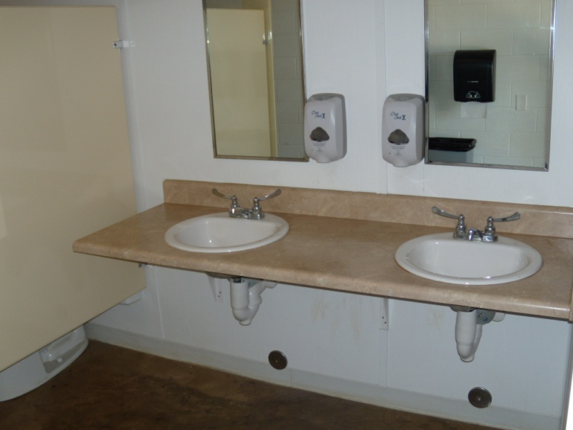
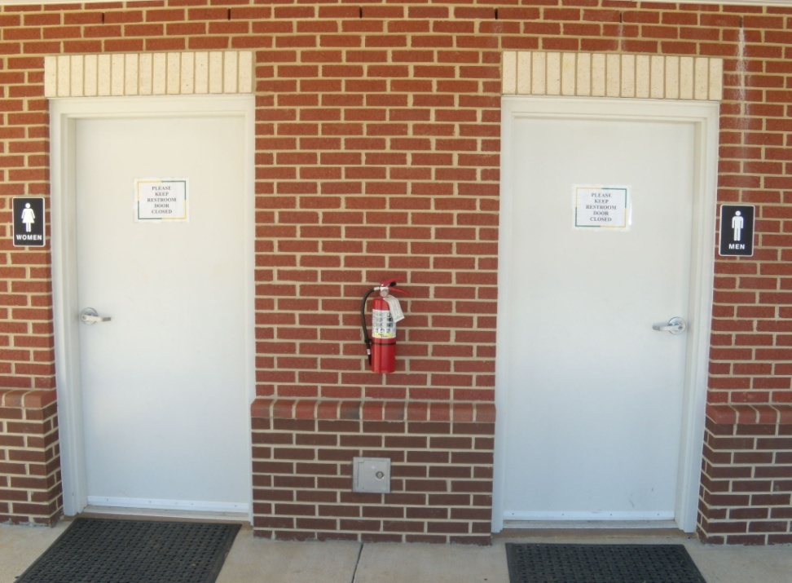
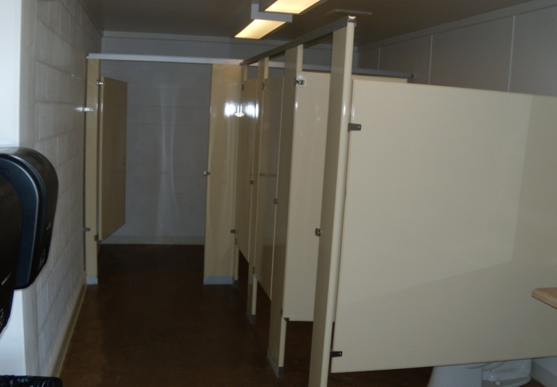
Men’s and Women’s facilities
Baby changing stations
ADA accessible
RESTROOMS
RESTROOMS

Slide 17
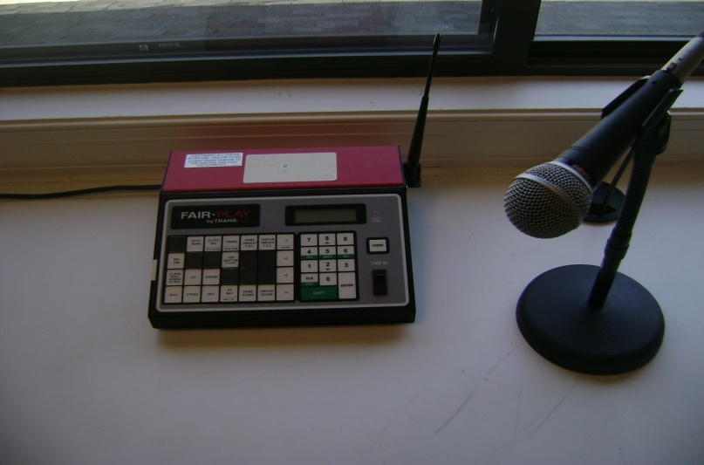
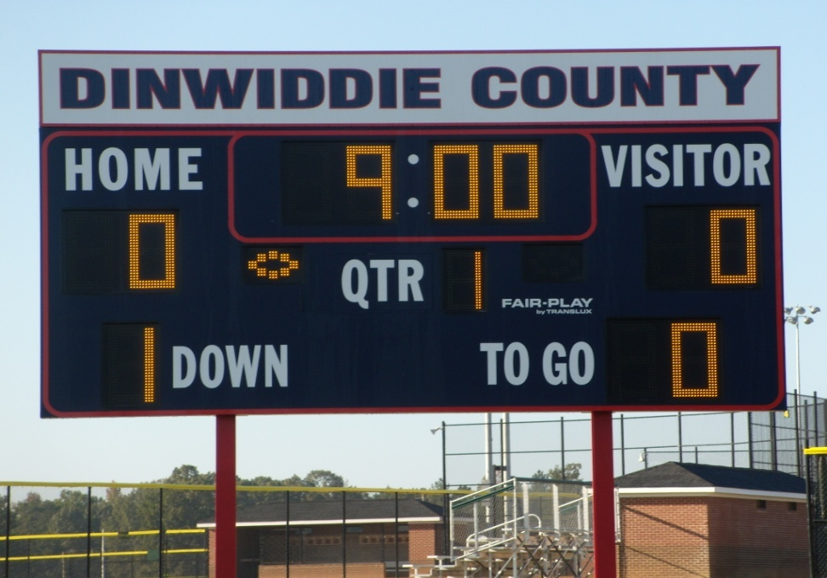
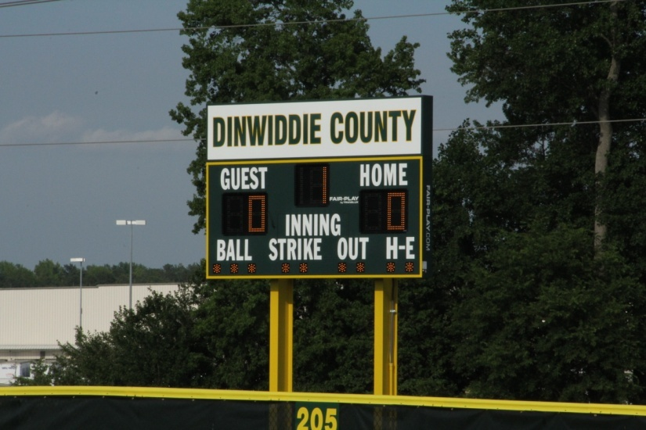
Lit scoreboard for each baseball/softball field
Wireless scoreboards
PA system available for each field
PRESS BOXES
SCOREBOARDS

Slide 18
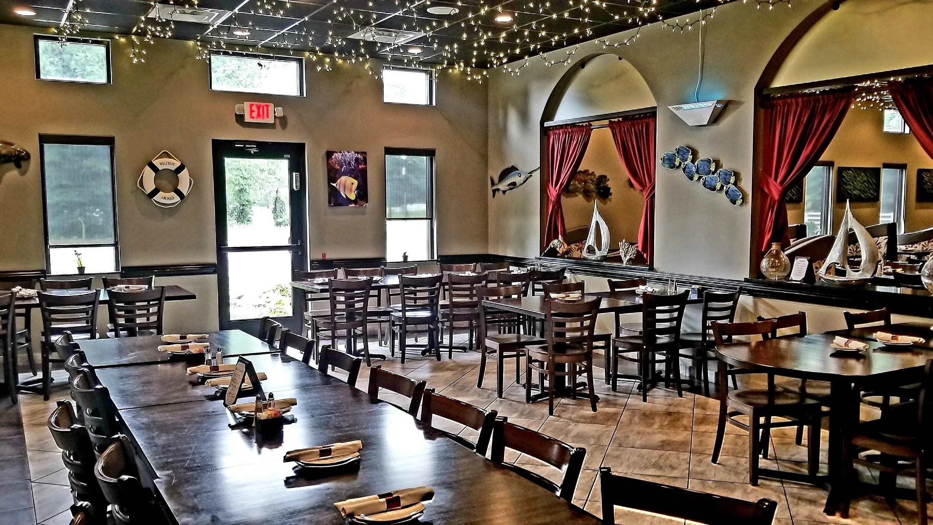
Dinwiddie County:
Brother’s Pizza Italian Restaurant
Giuseppe’s Pizza Italian Restaurant
Joe’s Steak & Seafood
Dinwiddie Diner
El Caporal
Waffle House
Richlands Creamery
Little Italy
Kentucky Fried Chicken
Burger King
McDonald’s
Hardee’s
Taco Bell
Subway
AND MORE!
DINING
DINING OPTIONS
Petersburg:
Alexander’s
Croaker’s Spot
Jimmy’s Grille
King’s Barbecue
Roma’s Italian Restaurant
DJ’s Rajun Cajun
Dixie Restaurant
Demolition Coffee
Mad Italian Pasta & Steakhouse
Maria’s Italian
Wabi-Sabi Sushi
The Brick House Run
Saucy’s Barbecue
AND MORE!
Colonial Heights:
Captain Tom’s Seafood
El Caporal
Chicken Fiesta
China Buffet
Shrimp Shack
Multiple Italian Restaurants!
Wagstaff’s Steak House
Sonic Drive-In
Los Bandidos
Olive Garden
Outback Steakhouse
Texas Road House
LongHorn Steakhouse
Chick-Fil-A
AND MORE!

Slide 19
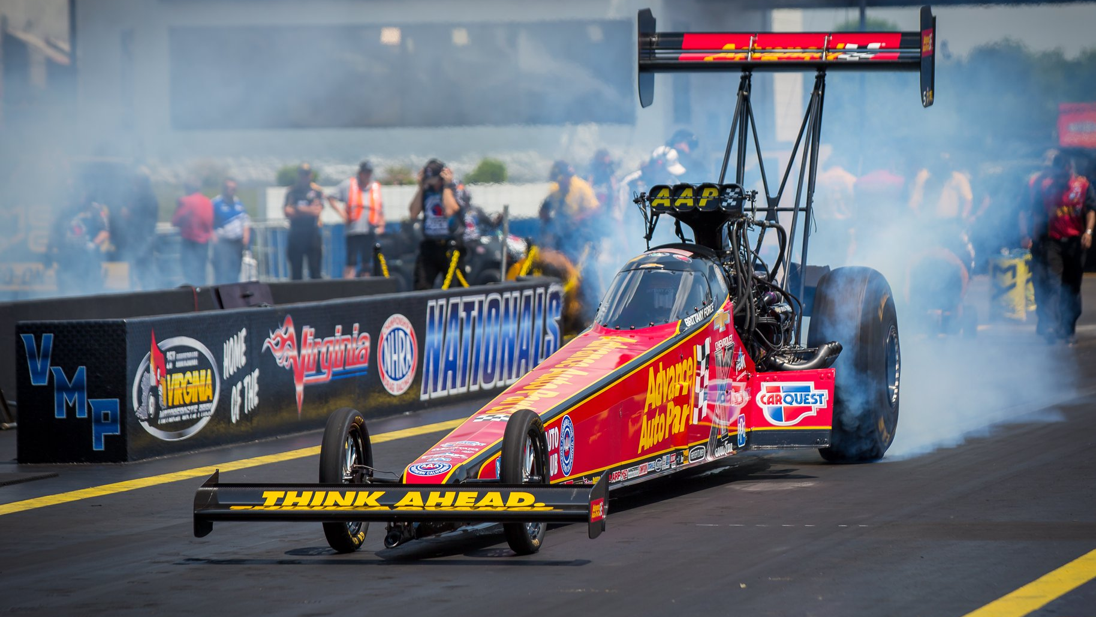
Dinwiddie County:
Richland Dairy & Creamery
Adams Acres “Pick your Own”
Appomattox River & Heritage Trail
Whippernock Marina & Campground
Picture Lake & Campground
Pamplin Civil War Park
Five Forks Battlefield
Lake Chesdin Marina
Virginia Motorsports Park
Lucky Lake Gem &Mineral Mine
ENTERTAINMENT
ENTERTAINMENT
Petersburg:
Old Towne Petersburg
Escape Room
Sycamore Rouge – Jazz performances
Petersburg Area Art League
Petersburg Regional Arts Center
Friday for the Arts
Dogwood Trace Golf Course
Petersburg National Battlefield
Colonial Heights:
Swift Creek Mill Theatre
Keystone Tractor Works
Violet Bank Civil War Museum
The Bowling Alley
Swader’s Sports Park
Southpark Mall

Slide 20
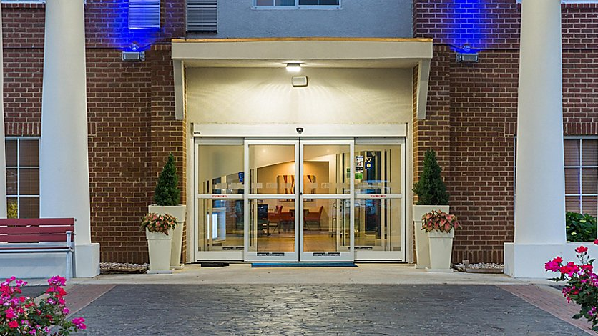
Dinwiddie County:
Holiday Inn Express Hotel
Camptown Campground
Picture Lake Campground
Lake Chesdin Campground
LODGING
LODGING OPTIONS
Petersburg/Prince George:
Country Inn & Suites
Hampton Inn Petersburg - Fort Lee
Holiday Inn Express Hotel
Howard Johnson Inn
Quality Inn Petersburg
Colonial Heights:
Candlewood Suites 23834
Comfort Suites Southpark
Hampton Inn Petersburg-Southpark Mall
Holiday Inn Petersburg-North Fort Lee
Hilton Garden Inn Southpark

Slide 21
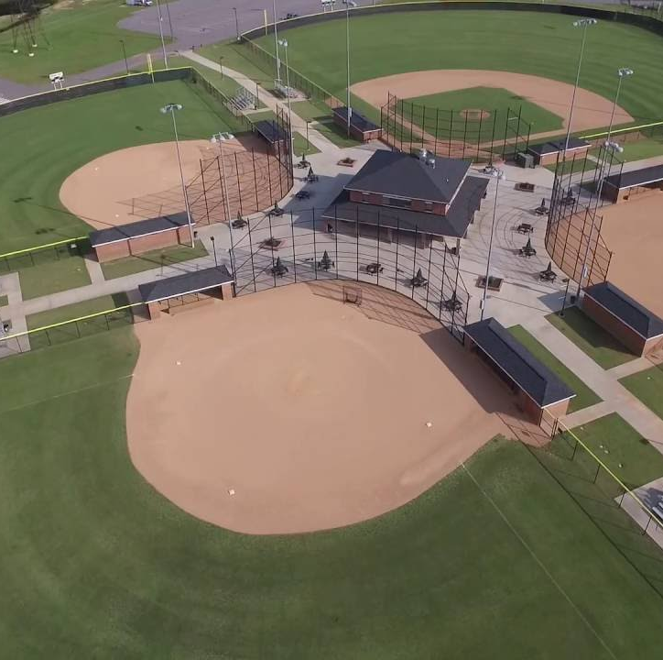
Make The Dinwiddie Sports Complex
The Home of Your Next Tournament!
5850 R.B. Pamplin Dr. Sutherland, VA 23885
Phone Number 1: 804-896-4946
Phone Number 2: 804-862-8086
Fax Number: 804-862-8097
THANK YOU!

